Slide 1
Fundamentals of Python: First Programs
Second Edition
Chapter 2
Software Development, Data Types, and Expressions

Slide 2
Objectives (1 of 2)
2.1 Describe the basic phases of software development: analysis, design, coding, and testing
2.2 Use strings for the terminal input and output of text
2.3 Use integers and floating point numbers in arithmetic operations
2.4 Construct arithmetic expressions
2.5 Initialize and use variables with appropriate names

Slide 3
Objectives (2 of 2)
2.6 Import functions from library modules
2.7 Call functions with arguments and use returned values appropriately
2.8 Construct a simple Python program that performs inputs, calculations, and outputs
2.9 Use docstrings to document Python programs

Slide 4
The Software Development Process (1 of 4)
Software development: process of planning and organizing a program
  Several approaches; one is the waterfall model
Waterfall model phases:
  Customer request (Requirements)
  Analysis
  Design – diagrams & pseudocode
  Implementation – write programs
  Integration – making the system work with other programs and systems
  Maintenance – from now until obsolescence
Modern software development is usually incremental and iterative
  Analysis and design may produce a prototype of a system for coding, and then back up to earlier phases to fill in more details after some testing
Notes:
Incremental and Iterative – sometimes you’re going backwards to adjust or add a piece to a prior step. Design may reveal errors in analysis.

Slide 5
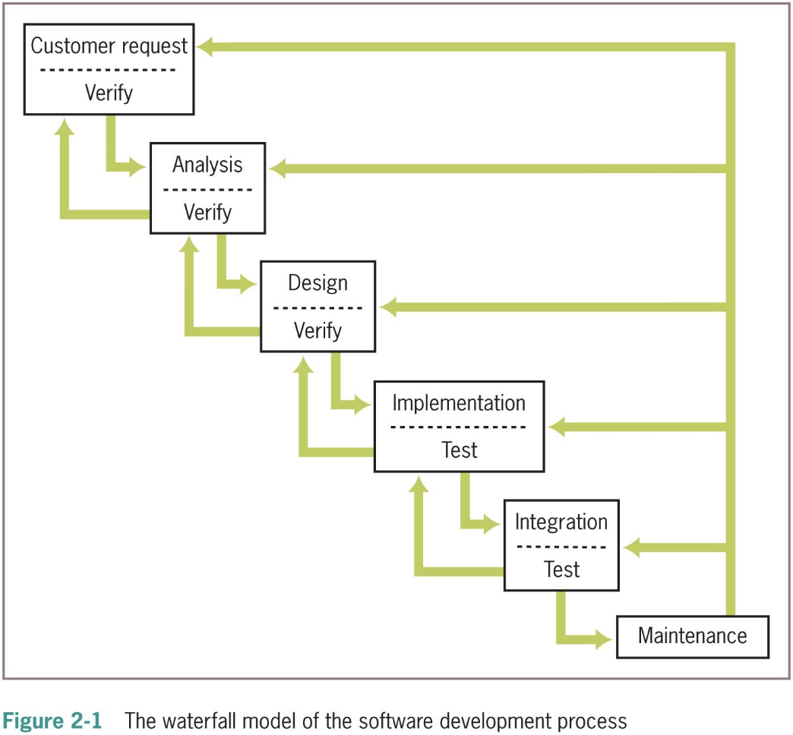
The Software Development Process (2 of 4)

Slide 6
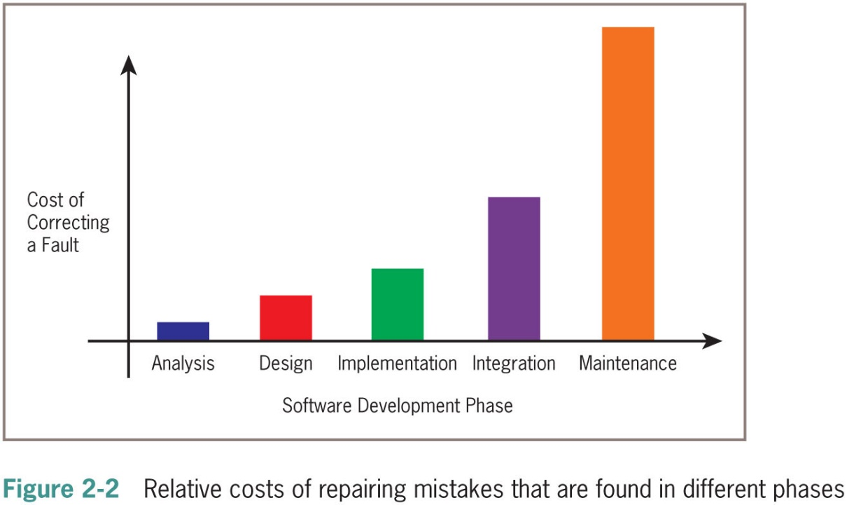
The Software Development Process (3 of 4)
Programs rarely work as hoped the first time they are run
  Must perform extensive and careful testing
  The cost of developing software is not spread equally over the phases

Slide 7
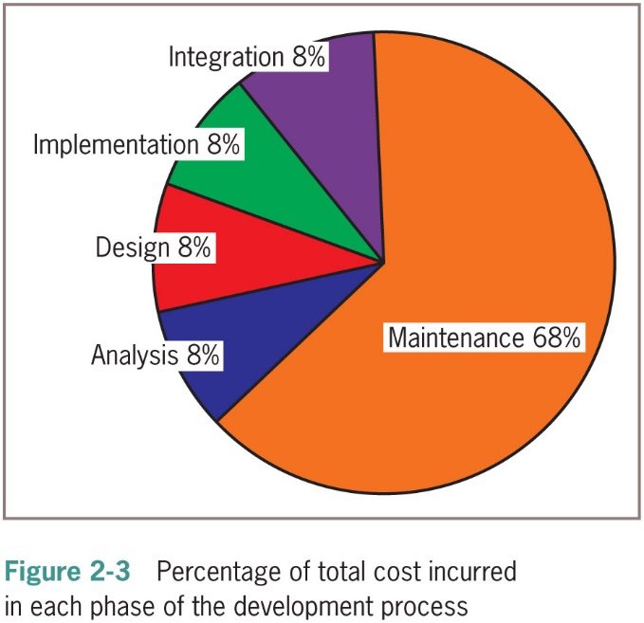
The Software Development Process (4 of 4)

Slide 8
Strings, Assignment, and Comments
Text processing is by far the most common application of computing
E-mail, text messaging, Web pages, and word processing all rely on and manipulate data consisting of strings of characters

Slide 9
Data Types (1 of 2)
A data type consists of a set of values and a set of operations that can be performed on those values
A literal is the way a value of a data type looks to a programmer
int and float are numeric data types
  They represent numbers

Slide 10
Data Types (2 of 2)
Type of Data | Python Type Name | Example Literals
Integers | int | −1, 0, 1, 2
Real numbers | float | −0.55, .3333, 3.14, 6.0
Character strings | str | “Hi”, “”, ‘A’, “66”

Slide 11
String Literals (1 of 2)
In Python, a string literal is a sequence of characters enclosed in single or double quotation marks
‘‘ and ”” represent the empty string
Double-quoted strings are handy for composing strings that contain single quotation marks or apostrophes:
>>> “I’m using a single quote in this string!”
“I’m using a single quote in this string!”
>>> print(“I’m using a single quote in this string!”)
I’m using a single quote in this string!

Slide 12
String Literals (2 of 2)
Use ‘‘‘ and ”””for multi-line paragraphs
>>> print(“””This very long sentence extends
all the way to the next line.”””)
This very long sentence extends all the way to the next line
When you evaluate a string in Python without the print function
  You can see the literal for the newline character, \n embedded in the result:
>>> “””This very long sentence extends
all the way to the next line.”””
‘This very long sentence extends\nall the way to the next line.’

Slide 13
Escape Sequences
The newline character \n is called an escape sequence
Escape Sequence | Meaning
\b | Backspace
\n | Newline
\t | Horizontal tab
\\ | The \ character
\’ | Single quotation mark
\” | Double quotation mark
Notes:
message = “Hello my name is \”Mud\”.”

Slide 14
String Concatenation
You can join two or more strings to form a new string using the concatenation operator +
>>> “Hi “ + “there,” + “Ken!”
‘Hi there, Ken!
The * operator allows you to build a string by repeating another string a given number of times
>>> “ “ * 10 + “Python”
‘Python’
>>> 'Python '*10
'Python Python Python Python Python Python Python Python Python Python '

Slide 15
Variables and the Assignment Statement (1 of 3)
A variable associates a name with a value
  Makes it easy to remember and use later in program
Variable naming rules:
  Reserved words cannot be used as variable names
    Examples: if, def, and import
  Name must begin with a letter or _
  Name can contain any number of letters, digits, or _
  Names are case sensitive
    Example: WEIGHT is different from weight
  Tip: begin each word in the variable name with an uppercase, except the first one (Example: interestRate) -CamelCase

Slide 16
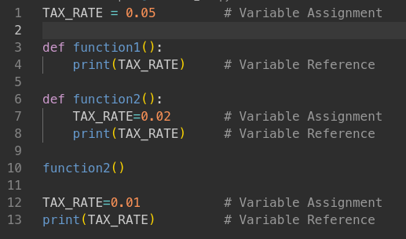
Variables and the Assignment Statement (2 of 3)
Programmers use all uppercase letters for symbolic constants (contain values that the program never changes)
  Examples: TAX_RATE and STANDARD_DEDUCTION
Variables receive initial values and can be reset to new values with an assignment statement
<variable name> = <expression>
  Subsequent uses of the variable name in expressions are known as variable references
Example:
>>> firstName = “Ken”
>>> secondName = “Lambert”
>>> fullName = firstName + “ ” + secondName
>>> fullName
‘Ken Lambert’

Slide 17
Variables and the Assignment Statement (3 of 3)
Variables serves two purposes:
  Help the programmer keep track of data that change over time
  Allow the programmer to refer to a complex piece of information with a simple name (called abstraction)

Slide 18
Program Comments and Doc strings (1 of 3)
Program comments
  A piece of program text that the computer ignores but that provides useful documentation to programmers
Doc string
  A multi-line string of the form
  Example:
“““
Program: circle.py
Author: Ken Lambert
Last date modified: 10/10/17
The purpose of this program is to compute the area of a circle. The input is an integer or floating-point number representing the radius of the circle. The output is a floating-point number labeled as the area of the circle.
”””

Slide 19
Program Comments and Doc strings (2 of 3)
End-of-line comments
  Begin with the # symbol and extend to the end of a line
  Might explain the purpose of a variable or the strategy used by a piece of code
  Example:
>>> RATE = 0.85 # Conversion rate for Canadian to US dollars

Slide 20
Program Comments and Doc strings (3 of 3)
Tips related to comments and doc strings:
  Begin a program with a statement of purpose and other information helpful to programmers
  Accompany a variable definition with a comment that explains the variable’s purpose
  Precede major segments of code with brief comments that explain their purpose
  Include comments to explain the workings of complex or tricky sections of code

Slide 21
Numeric Data Types and Character Sets
The first applications of computers were to crunch numbers
The use of numbers in many applications is still very important

Slide 22
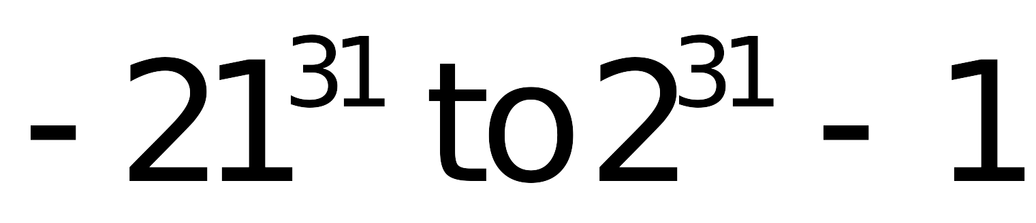
Integers
In real life, the range of integers is infinite
A computer’s memory places a limit on the magnitude of the largest positive and negative integers
  Python’s int typical range:
Integer literals are written without commas

Slide 23
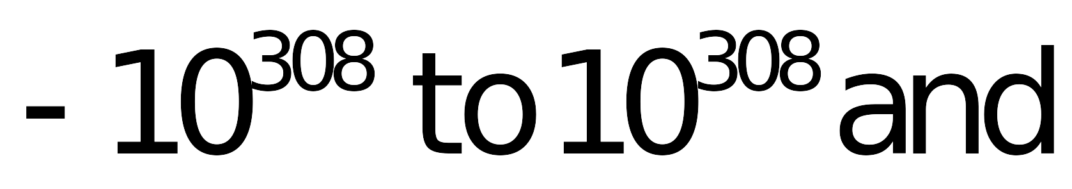
Floating-Point Numbers (1 of 2)
Real numbers have infinite precision
  The digits in the fractional part can continue forever
Python uses floating-point numbers to represent real numbers
Python’s float typical range:
Typical precision: 16 digits

Slide 24
Floating-Point Numbers (2 of 2)
A floating-point number can be written using either ordinary decimal notation or scientific notation
Decimal Notation | Scientific Notation | Meaning
3.78 | 3.78e0 | 3.78x10⁰
37.8 | 3.78e1 | 3.78x10¹
3780.0 | 3.78e3 | 3.78x10³
0.378 | 3.78e−1 | 3.78x10⁻¹
0.00378 | 3.78e−3 | 3.78x10⁻³

Slide 25
Character Sets
In Python, character literals look just like string literals and are of the string type
  They belong to several different character sets, among them the A S C I I set and the Unicode set
A S C I I character set maps to a set of integers
ord and chr functions convert characters to and from A S C I I
Example:
>>> ord(‘a’)
97
>>> ord(‘A’)
65
>>> chr(65)
‘A’
>>> chr(66)
‘B’

Slide 26
Expressions
A literal evaluates to itself
A variable reference evaluates to the variable’s current value
Expressions provide easy way to perform operations on data values to produce other values
When entered at Python shell prompt:
  an expression’s operands are evaluated
  its operator is then applied to these values to compute the value of the expression

Slide 27
Arithmetic Expressions (1 of 3)
An arithmetic expression consists of operands and operators combined in a manner that is already familiar to you from learning algebra
Operator | Meaning | Syntax
− | Negation | −a
** | Exponentiation | a ** b
* | Multiplication | a * b
/ | Division (produces a float result) | a / b
// | Quotient (produces an integer result) | a // b
% | Remainder or modulus | a % b
+ | Addition | a + b
− | Subtraction | a − b
Notes:
Quotient – divides but the result has no decimal places. They are truncated. No rounding is done.
Modulus – gives the remainder when division is done on two values. 5%2 → 1
Division – will output a float even when given “cleanly” divisible operands.

Slide 28
Arithmetic Expressions (2 of 3)
Precedence rules:
  ** has the highest precedence and is evaluated first
  Unary negation is evaluated next
  *, /, and % are evaluated before + and −
  + and − are evaluated before =
  With two exceptions, operations of equal precedence are left associative, so they are evaluated from left to right
    ** and = are right associative
  You can use () to change the order of evaluation

Slide 29
Arithmetic Expressions (3 of 3)
When both operands of an expression are of the same numeric type, the resulting value is also of that type
When each operand is of a different type, the resulting value is of the more general type except with the quotient and exact division operators.
  Example: 3 // 4 is 0, whereas 3 / 4.0 is .75
For multi-line expressions, use a \
Example:
>>> 3 + 4 * \
2 ** 5
131

Slide 30
Mixed-Mode Arithmetic and Type Conversions (1 of 4)
Mixed-mode arithmetic involves integers and floating-point numbers:
  >>> 3.14 * 3 ** 2
  28.26
You must use a type conversion function when working with input of numbers
  It is a function with the same name as the data type to which it converts
Input function returns a string as its value
  You must use the int or float function to convert the string to a number before performing arithmetic

Slide 31
Mixed-Mode Arithmetic and Type Conversions (2 of 4)
Conversion Function | Example Use | Value Returned
int(<a number or a string>) | int(3.77) int(“33”) | 3 33
float(<a number or a string>) | float(22) | 22.0
str(<any value>) | str(99) | ‘99’

Slide 32
Mixed-Mode Arithmetic and Type Conversions (3 of 4)
Note that the int function converts a float to an int by truncation, not by rounding
>>> int(6.75)
6
>>> round(6.75)
7

Slide 33
Mixed-Mode Arithmetic and Type Conversions (4 of 4)
Type conversion also occurs in the construction of strings from numbers and other strings
>>> profit = 1000.55
>>> print(‘$’ + profit)
Traceback (most recent call last):
File “<stdin>”, line 1, in <module>
TypeError: cannot concatenate ‘str’ and ‘float’ objects
Solution: use str function
>>> print(‘$’ + str(profit))
$1000.55
Python is a strongly typed programming language

Slide 34
Using Functions and Modules
Python includes many useful functions, which are organized in libraries of code called modules

Slide 35
Calling Functions: Arguments and Return Values
A function is chunk of code that can be called by name to perform a task
Functions often require arguments or parameters
  Arguments may be optional or required
When function completes its task, it may return a value back to the part of the program that called it
To learn how to use a function’s arguments, use the help function:
>>> help(round)
Help on built-in function round in module builtin:
round(…)
round(number[, n digits]) -> floating point number
Round a number to a given precision in decimal digits (default 0 digits).
This returns an int when called with one argument, otherwise the same type as
number, n digits may be negative.

Slide 36
The Math Module (1 of 2)
Functions and other resources are coded in components called modules
Functions like abs and round from the _builtin_ module are always available to use
The math module includes functions that perform basic mathematical operations
To use a resource from a module, you write the name of a module as a qualifier, followed by a dot (.) and the name of the resource
  Example: math.pi
>>>math.pi
3.1415926535897931
Math.sqrt(2)
1.4142135623730951

Slide 37
The Math Module (2 of 2)
You can avoid the use of the qualifier with each reference by importing the individual resources
>>> from math import pi, sqrt
>>>print(pi, sqrt(2))
3.14159265359 1.41421356237
You may import all of a module’s resources to use without the qualifier
  Example: from math import *

Slide 38
The Main Module
In the case study, earlier in this chapter, we showed how to write documentation for a Python script
To differentiate this script from the other modules in a program, we call it the main module
  Like any module, the main module can be imported
>>> import taxform
Enter the gross income: 120000
Enter the number of dependents: 2
The income tax is $20800.0
After importing a main module, view its documentation by running the help function

Slide 39
Program Format and Structure
Start with comment with author’s name, purpose of program, and other relevant information
  In a doc string
Then, include statements that:
  Import any modules needed by program
  Initialize important variables, suitably commented
  Prompt the user for input data and save the input data in variables
  Process the inputs to produce the results
  Display the results

Slide 40
Running a Script from a Terminal Command Prompt (1 of 4)
A way to run a Python script:
  Open a terminal command prompt window
  Click in the “Type here to search” box, type Command Prompt, and click Command Prompt in the list
  Navigate or change directories until the prompt shows directory that contains the Python script
  Run the script by entering:
    python3 scriptname.py

Slide 41
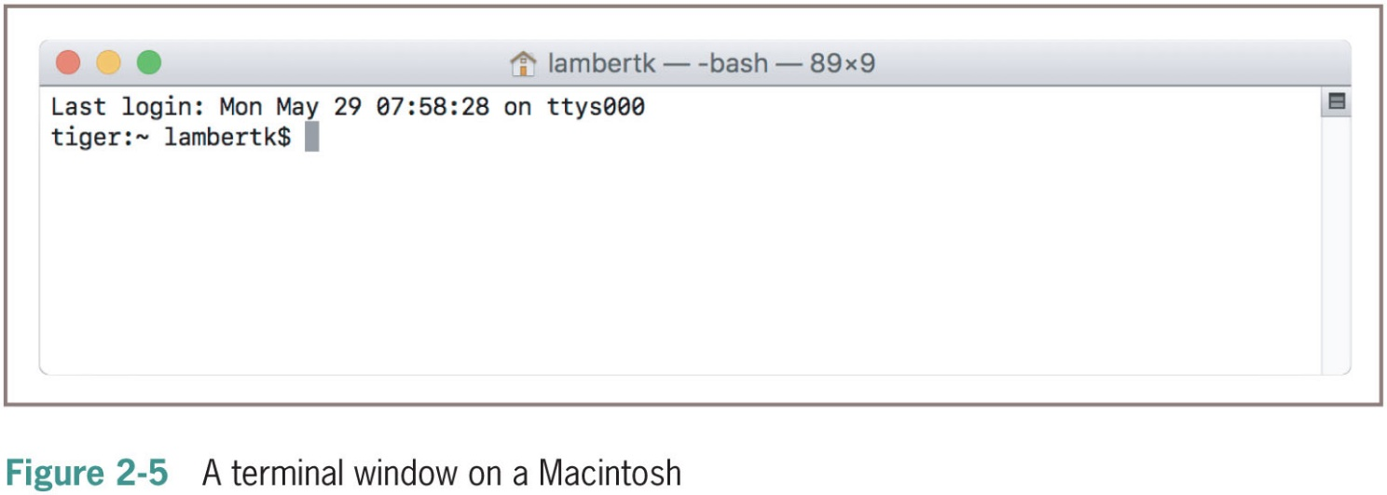
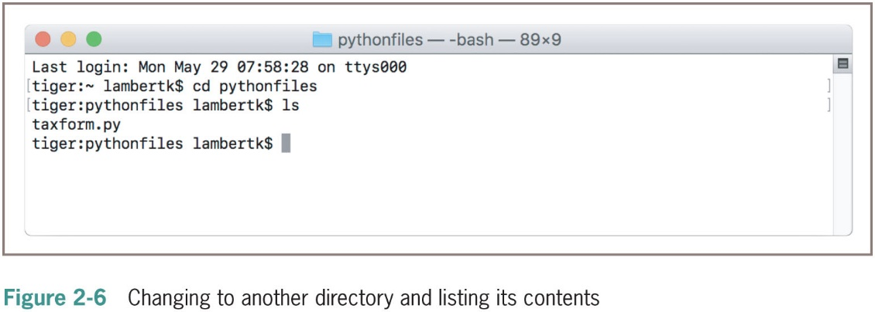
Running a Script from a Terminal Command Prompt (2 of 4)

Slide 42
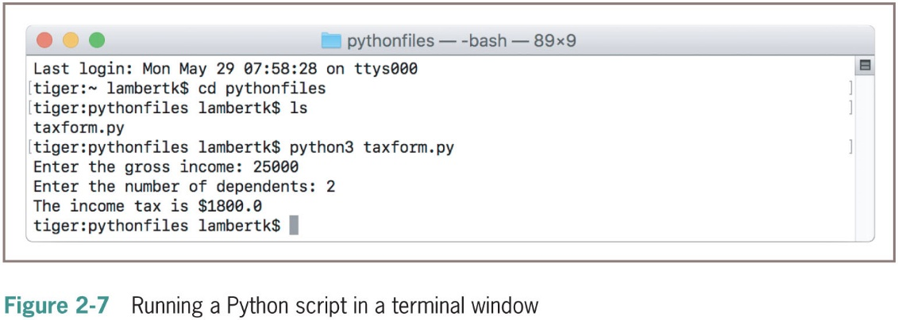
Running a Script from a Terminal Command Prompt (3 of 4)

Slide 43
Running a Script from a Terminal Command Prompt (4 of 4)
Python installations enable you to launch Python scripts by double-clicking the files from the O S’s file browser
  May require .py file type to be set
  Fly-by-window problem: Window will close automatically
    Solution: Add an input statement at end of script that pauses until the user presses the enter or return key
Input(“Please press enter or return to quit the program. ”)

Slide 44
Chapter Summary (1 of 3)
Waterfall model describes software development process in terms of several phases
Literals are data values that can appear in program
The string data type is used to represent text for input and output
Escape characters begin with backslash and represent special characters such as delete key
A doc string is string enclosed by triple quotation marks and provides program documentation

Slide 45
Chapter Summary (2 of 3)
Comments are pieces of code not evaluated by the interpreter but can be read by programmers to obtain information about a program
Variables are names that refer to values
Some data types: int and float
Arithmetic operators are used to form arithmetic expressions
  Operators are ranked in precedence
Mixed-mode operations involve operands of different numeric data types
Type conversion functions can be used to convert a value of one type to a value of another type after input

Slide 46
Chapter Summary (3 of 3)
A function call consists of a function’s name and its arguments or parameters
  May return a result value to the caller
Python is a strongly typed language
A module is a set of resources
  Can be imported
A semantic error occurs when the computer cannot perform the requested operation
A logic error produces incorrect results``

